Slide 1


tile
Codex Company
Insights of Food And Beverage
Presented by :- Manish Kumar
Notes:
textbox
No alt text provided
image
No alt text provided
textbox
No alt text provided
image
No alt text provided
image
No alt text provided

Slide 2




tile
Overview of Company
About Data
Agenda
Objective
Ad Hoc Request with Insights
Notes:
textbox
No alt text provided
image
No alt text provided
textbox
No alt text provided
image
No alt text provided
image
No alt text provided

Slide 3
tile
CodeX is a German beverage company that is aiming to make its mark in the Indian market. A few months ago, they launched their energy drink in 10 cities of India.
Codex product is Food and beverage they launched there energy drink recently. Now they want to know how there product work.
They also conduct a survey and collected the data, now from the data they want to know how there product perform and what the point or area in which they have to focus for there product growth in the market.
Overview of Company
Notes:
textbox
No alt text provided
image
No alt text provided
textbox
No alt text provided
image
No alt text provided
image
No alt text provided

Slide 4
tile
In Data there are 3 Tables
Dim_cities
Dim_repondents
Fact_survey_responses
City_ID
City
Tier
Respondent_ID
Name
Age
Gender
City_ID
Response_ID
Respondent_ID
Consume_frequency
Consume_time
Consume_reason
Heard_before
Brand_perception
General_perception
Tried_before
Taste_experience
Reasons_preventing_trying
Current_brands
Reasons_for_choosing_brands
Improvements_desired
Ingredients_expected
Health_concerns
Interest_in_natural_or_organic
Marketing_channels
Packaging_preference
Limited_edition_packaging
Price_range
Purchase_location
Typical_consumption_situations
About Data
Notes:
textbox
No alt text provided
image
No alt text provided
textbox
No alt text provided
image
No alt text provided
image
No alt text provided

Slide 5
tile
To create a dashboard for the Marketing team is responsible for increasing brand awareness, market share, and product development. Marketing team at Codex that facilitates a deeper understanding of the Indian market, enabling data-driven decision-making to effectively impact the market.
Assist the management team to gain more insights about the business
Take data-driven decisions to scale business.
Objective
Notes:
textbox
No alt text provided
image
No alt text provided
textbox
No alt text provided
image
No alt text provided
image
No alt text provided

Slide 6
tile
Let Start the Ad Hoc Question with SQL Query, Output and Data Visual
Notes:
textbox
No alt text provided
image
No alt text provided
textbox
No alt text provided
image
No alt text provided
image
No alt text provided

Slide 7
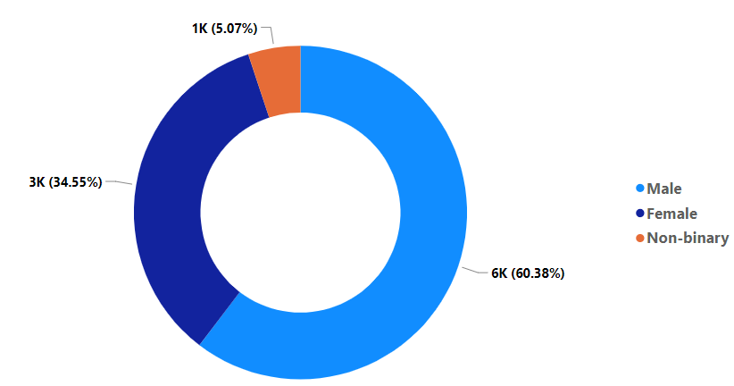
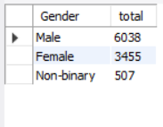
tile
Question 1 Demographic Insights (examples)
a. Who prefers energy drink more? (male/female/non-binary?)
Output
Male prefer the more energy drink.
Notes:
textbox
No alt text provided
image
No alt text provided
textbox
No alt text provided
image
No alt text provided
image
No alt text provided

Slide 8
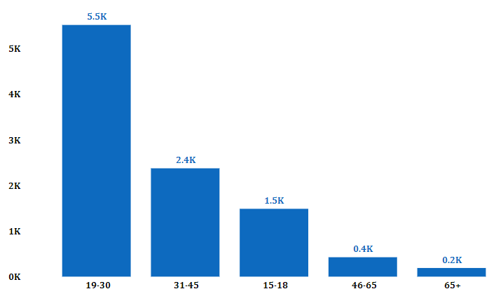
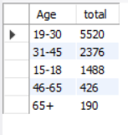
tile
Question 1 Demographic Insights (examples)
b. Which age group prefers energy drinks more?
Output
19-30 Age group prefer the more energy drink its approx. 5.5 K.
Notes:
textbox
No alt text provided
image
No alt text provided
textbox
No alt text provided
image
No alt text provided
image
No alt text provided

Slide 9
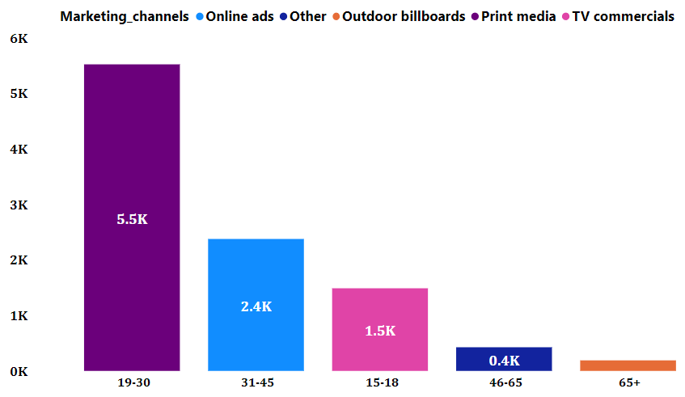
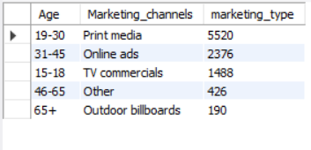
tile
Question 1 Demographic Insights (examples)
c. Which type of marketing reaches the most Youth (15-30)?
Output
Print Media are the most reachable marketing channel to the youth between the age of (15-30).
Notes:
textbox
No alt text provided
image
No alt text provided
textbox
No alt text provided
image
No alt text provided
image
No alt text provided

Slide 10
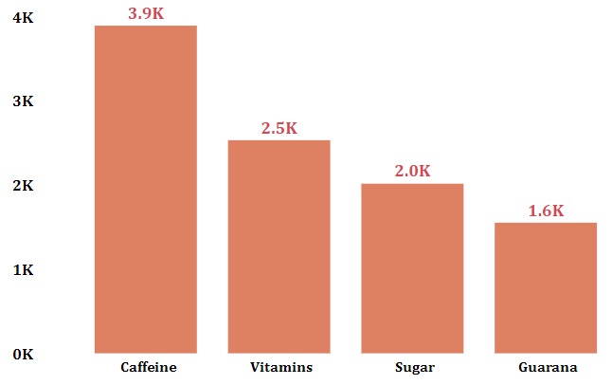
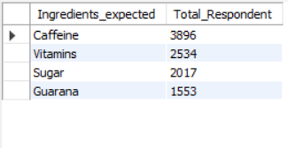
tile
Question 2 Consumer Preferences
a. What are the preferred ingredients of energy drinks among respondents?
Output
Caffeine are the most preferred ingredients of energy drinks among respondents.
Notes:
textbox
No alt text provided
image
No alt text provided
textbox
No alt text provided
image
No alt text provided
image
No alt text provided

Slide 11
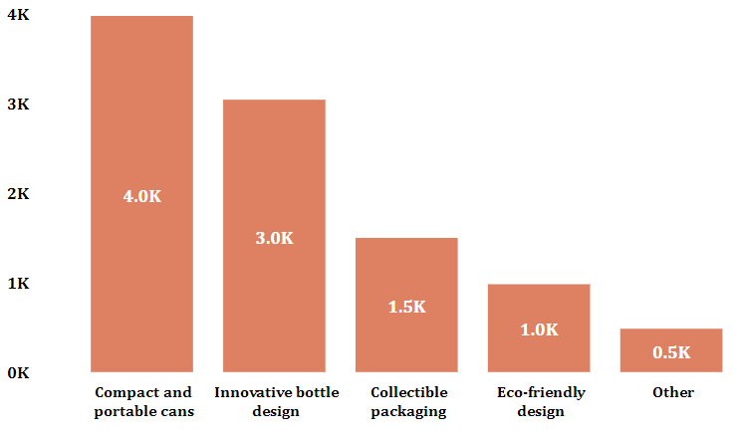
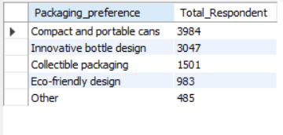
tile
Question 2 Consumer Preferences
b. What packaging preferences do respondents have for energy drinks?
Output
Compact and portable cans are the most popular packaging preferences among consumers.
Notes:
textbox
No alt text provided
image
No alt text provided
textbox
No alt text provided
image
No alt text provided
image
No alt text provided

Slide 12
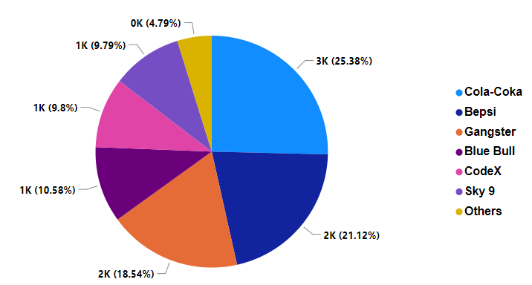
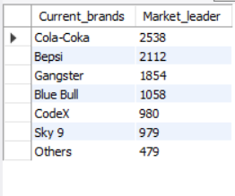
tile
Question 3 Competition Analysis
a. Who are the current market leaders?
Output
Cola-Coka are the current market leaders in the energy drinks business it acquire the approx. 25% and our product are at approx. 10% .
Notes:
textbox
No alt text provided
image
No alt text provided
textbox
No alt text provided
image
No alt text provided
image
No alt text provided

Slide 13
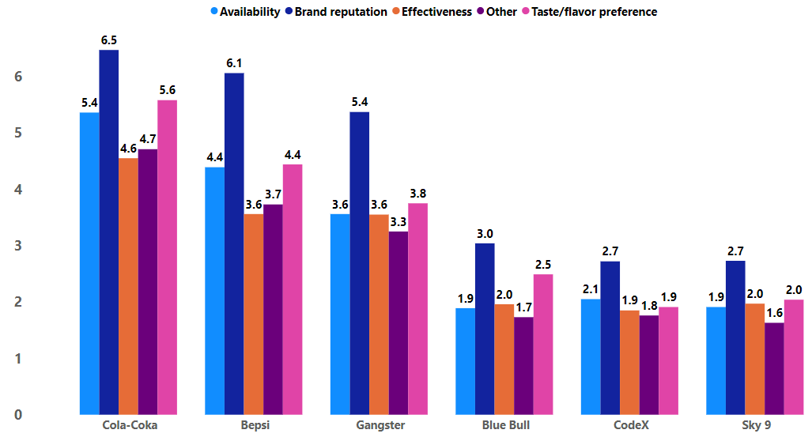
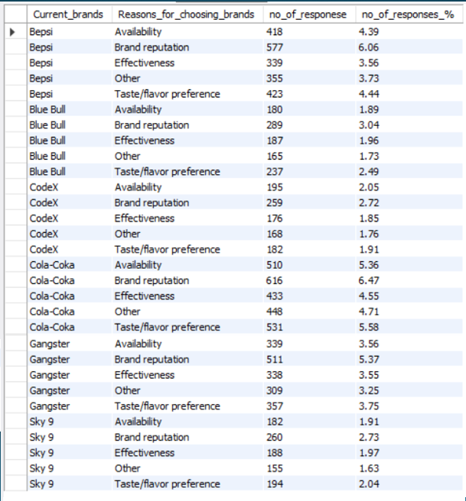
tile
Question 3 Competition Analysis
b. What are the primary reasons consumers prefer those brands over ours?
Output
So we can see there is not a particular reason why other drinks prefer more but if we compare we can say that Brand reputation and Taste/flavor are the primary reason.
Notes:
textbox
No alt text provided
image
No alt text provided
textbox
No alt text provided
image
No alt text provided
image
No alt text provided

Slide 14
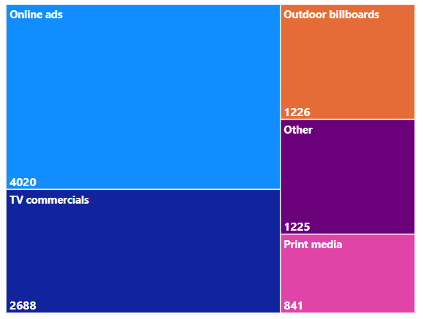
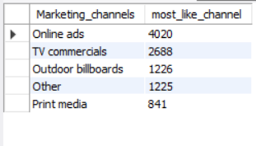
tile
Question 4 Marketing Channels and Brand Awareness
Which marketing channel can be used to reach more customers?
Output
The online ad channel is the most effective marketing strategy for promoting the brands among youths.
Notes:
textbox
No alt text provided
image
No alt text provided
textbox
No alt text provided
image
No alt text provided
image
No alt text provided

Slide 15
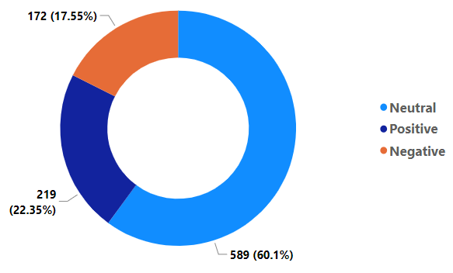
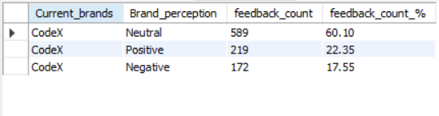
tile
Question 5 Brand Penetration
a. What do people think about our brand? (overall rating)
Output
About 60% customer have neutral feedback about CodeX.
Notes:
textbox
No alt text provided
image
No alt text provided
textbox
No alt text provided
image
No alt text provided
image
No alt text provided

Slide 16
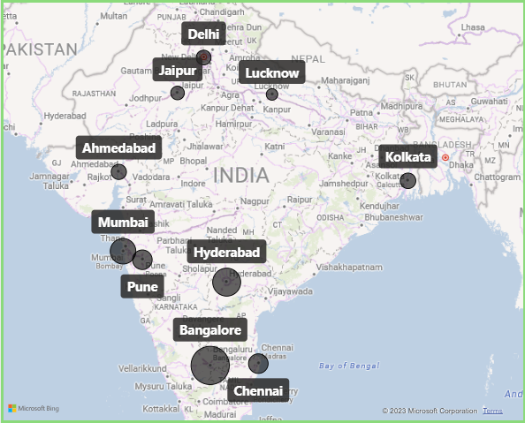
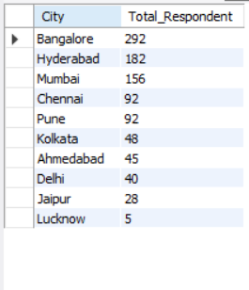
tile
Question 5 Brand Penetration
b. Which cities do we need to focus more on?
Output
In Lucknow over brand not perform well so we have to focus more on Luckow and we also have to focus on other city like Kolkata, Ahmedabad, Delhi, Jaipur were only 5% customer use over product.
Notes:
textbox
No alt text provided
image
No alt text provided
textbox
No alt text provided
image
No alt text provided
image
No alt text provided

Slide 17
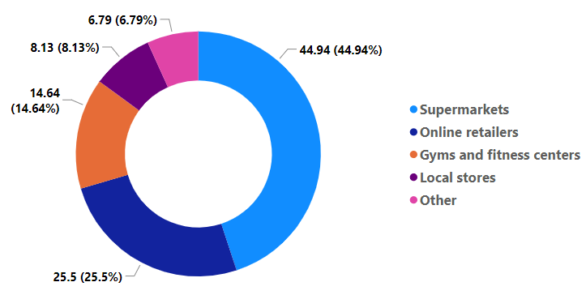
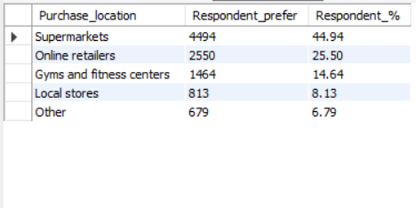
tile
Question 6 Purchase Behavior
a. Where do respondents prefer to purchase energy drinks?
Output
Supermarket are the most prefer for purchase of energy drink. Over approx. 45% customer buy from the supermarket and the second prefer is online which is approx. 25%.
Notes:
textbox
No alt text provided
image
No alt text provided
textbox
No alt text provided
image
No alt text provided
image
No alt text provided

Slide 18
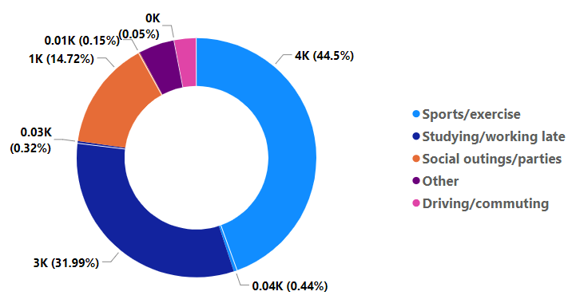
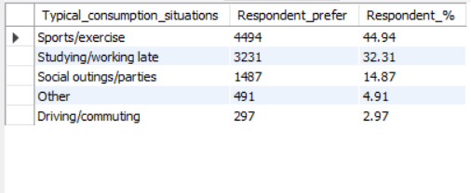
tile
Question 6 Purchase Behavior
b. What are the typical consumption situations for energy drinks among respondents?
Output
Over approx. 44% customer consume over energy drink for sport and exercise.
Notes:
textbox
No alt text provided
image
No alt text provided
textbox
No alt text provided
image
No alt text provided
image
No alt text provided

Slide 19
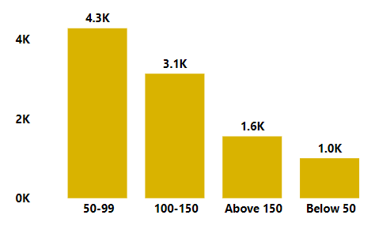
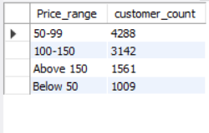
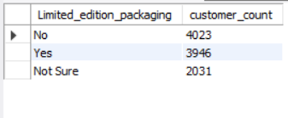
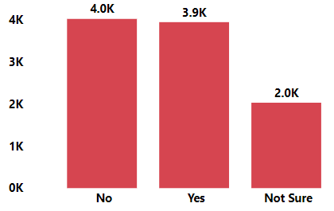
tile
Question 6 Purchase Behavior
c. What factors influence respondents' purchase decisions, such as price range and limited edition packaging?
Output
In price range most of the customer prefer the lower price.
The limited edition not impact the more on sale because it approx. 50-50 for limited edition.
Notes:
textbox
No alt text provided
image
No alt text provided
textbox
No alt text provided
image
No alt text provided
image
No alt text provided

Slide 20
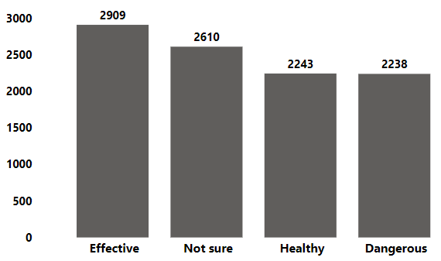
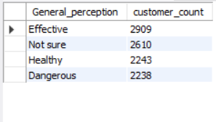
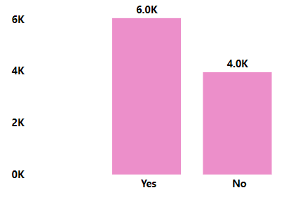
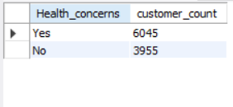
tile
Question 6 Purchase Behavior
In General perception the effectiveness is consider the most.
Most of the customer are health conscious
Notes:
textbox
No alt text provided
image
No alt text provided
textbox
No alt text provided
image
No alt text provided
image
No alt text provided

Slide 21
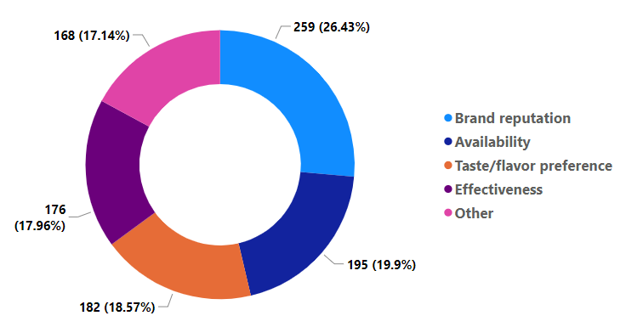
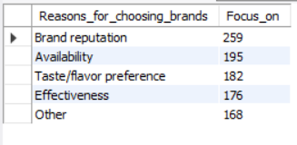
tile
Question 7 Product Development
a. Which area of business should we focus more on our product development? (Branding/taste/availability)
Output
If we consider only the (Branding/taste/availability) then we have to focus more on the availability of the product. But if we see all over then we have to focus on the effectiveness of the product.
Notes:
textbox
No alt text provided
image
No alt text provided
textbox
No alt text provided
image
No alt text provided
image
No alt text provided

Slide 22
tile
Thank You
Notes:
textbox
No alt text provided
image
No alt text provided
textbox
No alt text provided
image
No alt text provided
image
No alt text provided

